Slide 1

Canary Deploys

Slide 2
About me
Software Developer @ Kroger
12 years
@adam.r.mcclain
linkedin.com/in/adam-mcclain-bb304262
github.com/adamrmcclain

Slide 3
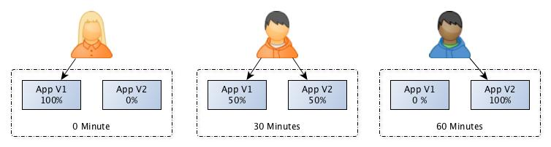
What is a Canary Deploy?
A Canary Deploy is a deployment that occurs over a short period of time, and slowly moves traffic over from an old version of an application to a new version of the same application.

Slide 4
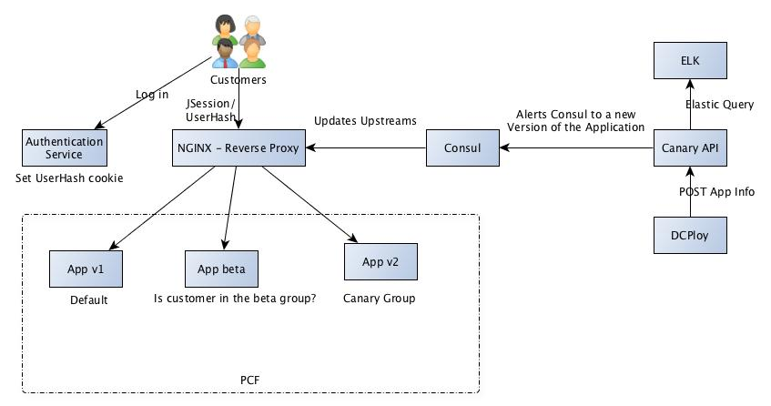
Canary Overview
Notes:
DCPloy
- our custom wrapper around the cf cli tool
- gives us multi-foundation awareness
- allows us to validate enterprise wide standards (autoscaling for example)
- simplifies deployment steps across all of our teams
Canary API
- the webservice we wrote to manage the integration between consul, dcploy, and our ELK Stack
- used to calculate user buckets
- updates Consul every minute with the new buckets for application versions
ELK Stack (Elastic Search, Logstash, Kibana)
- Log aggregation platform.
- We use this to help automate rollbacks, which we will talk about later.
Consul (hashicorp)
- Service Discovery tool
- We're using Consul's Key Value store in order to store information about the deploy (version, groups, etc).
- Consul Agent and Consul Template are installed on the NGINX servers
- Consul Template takes a template file and populates it with values from the Consul agent, when updates are made to the main Consul Cluster
- These agents receive updates from the main Consul Cluster and uses Consul Template to update the NGINX upstreams
NGINX
- Open Source Reverse Proxy
- Allows us to Dynamically route traffic based on headers/cookies and regular expressions.
PCF (Pivotal Cloud Foundry)
- Our on prem cloud solution.
- It allows us to deploy any number of versions of an application.

Slide 5
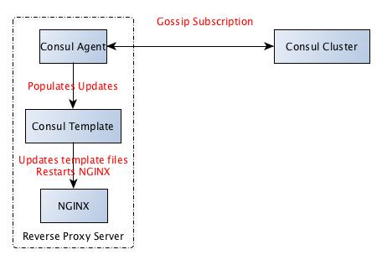
Consul - NGINX

Slide 6
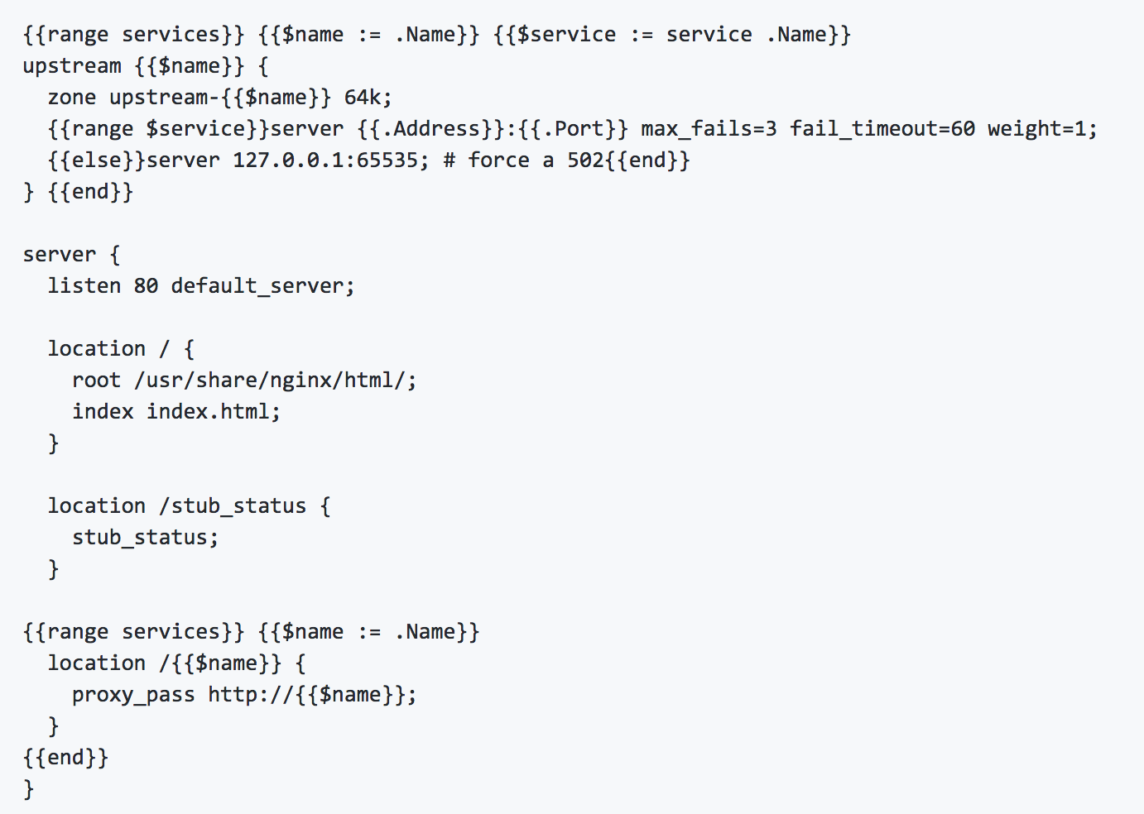
Notes:
https://github.com/hashicorp/consul-template/blob/master/examples/nginx.md

Slide 7
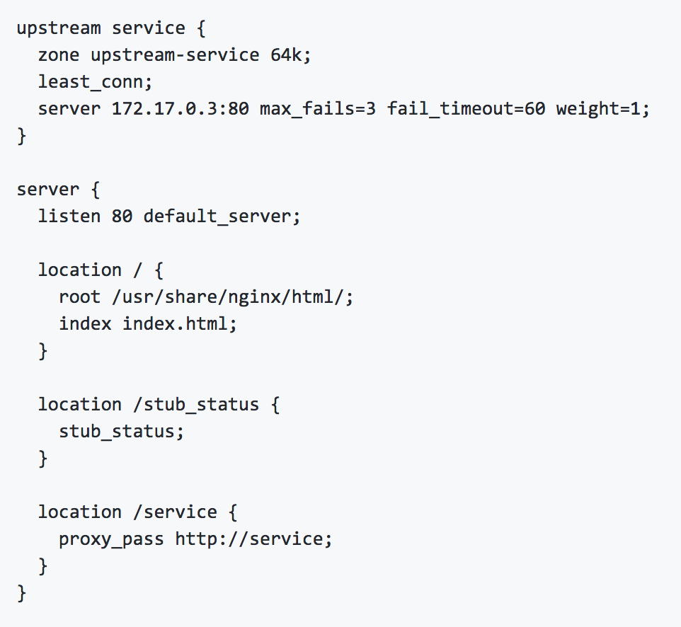

Slide 8
Demo!
Notes:
https://gitlab.kroger.com/dcploy/canary-demo-webapp/blob/master/.dcploy.yml#L23
https://gitlab.kroger.com/dcploy/canary-demo-webapp/blob/feature-candidate/assets/template/index.html#L84

Slide 9

Notes:
A Canary Deploy is great, but you have to have a way to monitor the health of the newest version of your application. You can rely on manual testing over the duration of your deploy if you want, but if you want a true CI/CD experience you need to automate your rollback procedure as well.
We are using the ELK stack to help with this monitoring. All of our teams are pushing their logs to our ELK stack, which we can then use to monitor the healthy of our canary. We’ve given the users the flexibility to define an Elastic Search Query to allow them to automatically roll back when their rollback query criteria met.

Slide 10
Rollback Demo
Notes:
https://gitlab.kroger.com/dcploy/canary-demo-webapp/blob/master/.dcploy.yml#L27
https://gitlab.kroger.com/dcploy/canary-demo-webapp/blob/master/canary_echo_query.tmpl
https://canary-demo-dev-{version}.cfcdcinternaltest.kroger.com/api/set-unhealthy

Slide 11
Feature Candidates
AKA: Beta
Notes:
Feature Candidates (or Beta releases) are a way to deploy test features to production and not expose them to your core customer base. We’ve implemented this again by using regular expressions in NGINX and redirecting traffic to a the Feature Candidate version in PCF.
The key for feature candidates, is it only works when a user is distinguishable. We’re basing this off of a beta user flag that is attached to a user’s profile.

Slide 12
Feature Candidate Demo

Slide 13
Gotchas
API Versioning
Currently only works with NGINX
Autoscaling
Only works with web apps (UI, Services, etc)
Connection Pools
Notes:
API Versioning: You have to be backwards compatible with these changes. If you’re making a breaking change during a canary deploy, one set of users is guaranteed to have a negative experience. Version your endpoints when you make these breaking changes (it’s bound to happen)
Autoscaling: We’ve currently set this up to autoscale to the minimum acceptable instances, with the understanding that PCF will scale applications as it beings to get more traffic. An application needs to have the correct autoscaling rules set up, or else they could see performance drop off when cutting over to the new version.
Web Apps: Don’t expect to use this with a batch process or something that reads messages off of a queue. This has only been built for applications that get customer facing traffic
Connection Pools: When NGINX reloads, it can impact performance of applications using it as a Reverse Proxy. If the client is using a Connection Pool, there will be stale connections. We are currently working on removing the need to use the Nginx reload command.

Slide 14
Links
Learn more about ELK: https://www.elastic.co/elk-stack
Learn more about Consul: https://www.consul.io/
Learn more about NGINX: https://www.nginx.com/
Learn more about PCF: https://pivotal.io/platform
Consul Template Example: https://github.com/hashicorp/consul-template/blob/master/examples/nginx.md

Slide 15
Questions?

